Slide 1
CNS 187 Final Project
Fengqing Yu

Slide 2
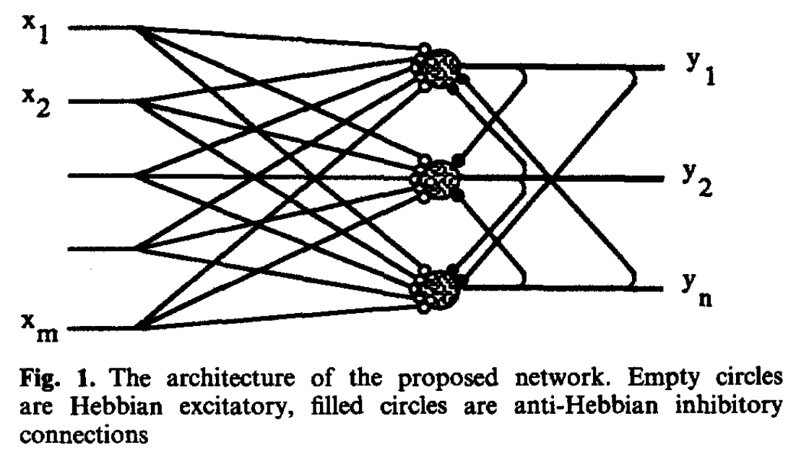
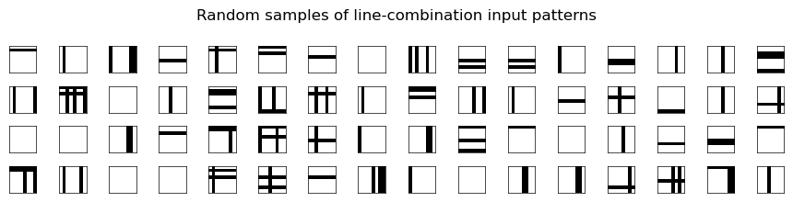
Replication
Foldiak 1990
Model
Dataset

Slide 3
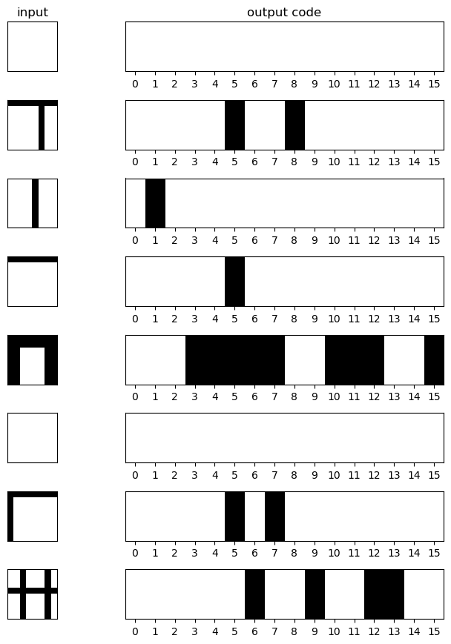
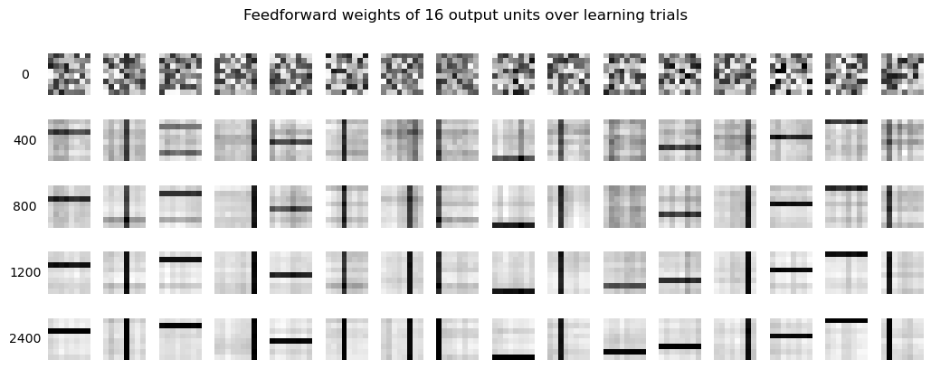
Replication

Slide 4
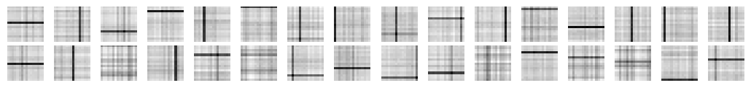
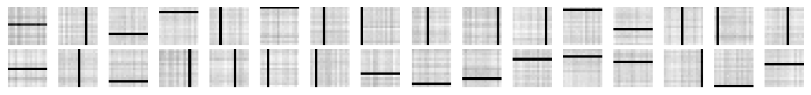
Model Fails to Discover Independent Components for Higher Line Probabilities
Larger Images (16x16) Requires More Steps to Learn
1200 steps
5000 steps

Slide 5
High Hebbian rate -> redundant features (units converge before decorrelating)
High Anti-Hebbian rate -> independent components (stronger suppression of co-activation)
Notes:
A high Hebbian learning rate causes units to converge onto similar features before decorrelation can take effect, increasing redundancy. A higher anti-Hebbian learning rate counteracts this by more aggressively suppressing co-activation, driving units toward statistically independent components

Slide 6
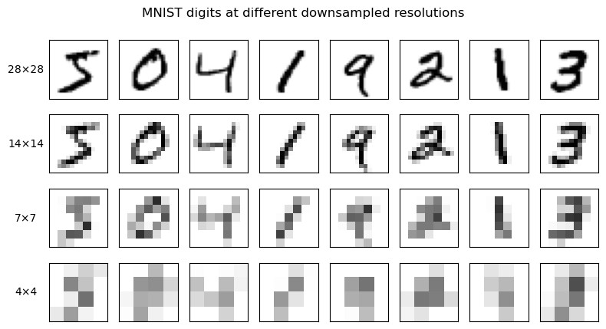




Application to MNIST Dataset
60,000 Training Images

Slide 7

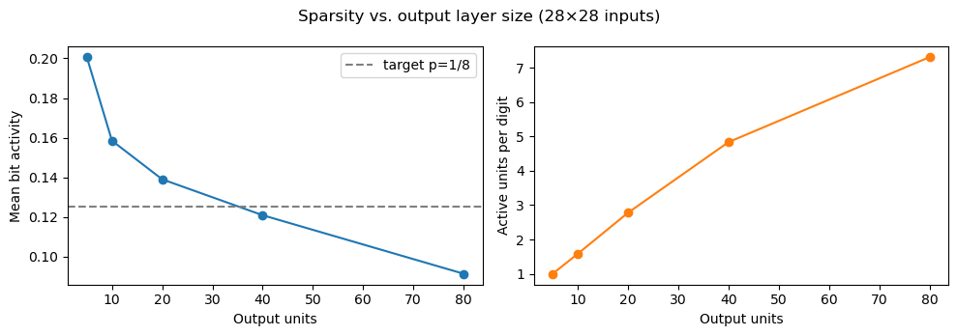

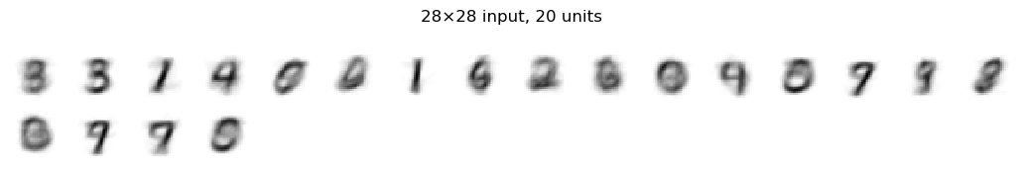
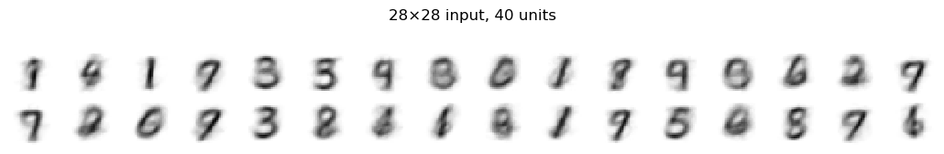
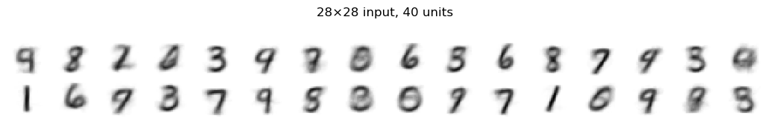
Increasing output layer size decreases mean activity per unit, but the learned features remain whole-digit templates regardless of capacity
with target p=1/40
Notes:
centered MNIST digits are the most statistically independent recurring units in this dataset, rather than strokes or parts.

Slide 8
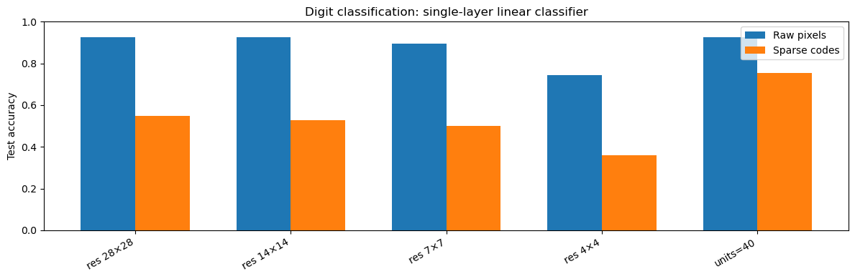
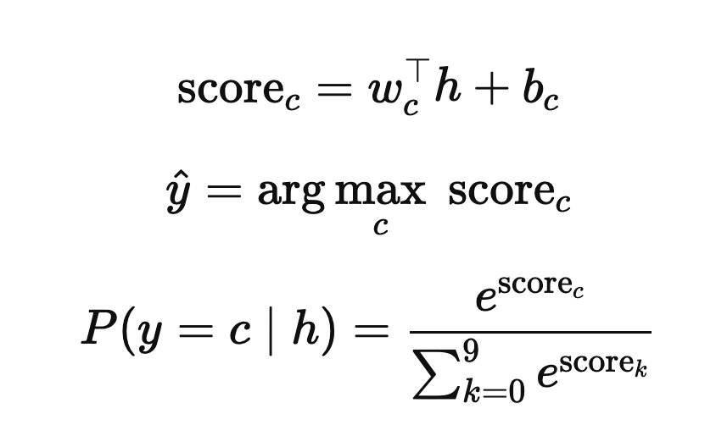
Training on the discovered sparse code does not help classification
Also tried with units = 80: train=0.613, test=0.613

Slide 9
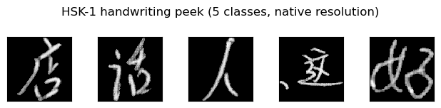
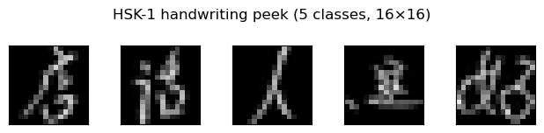
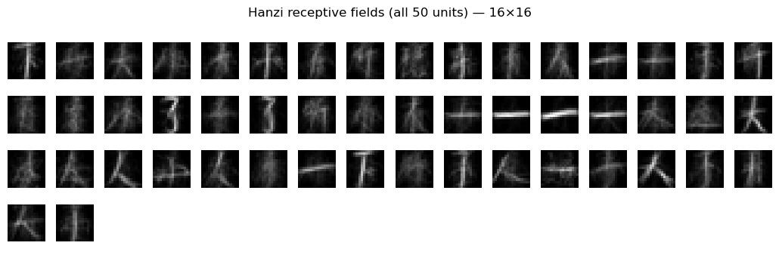
Application to Chinese Handwriting Characters From Kaggle

Slide 10
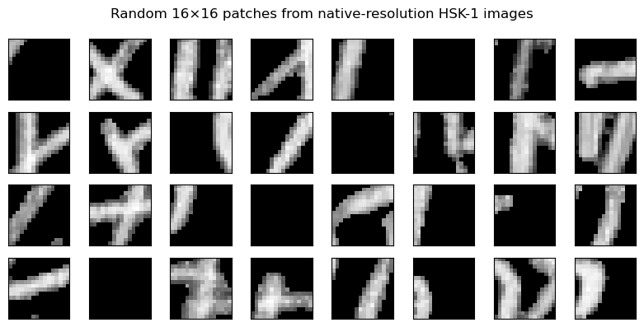
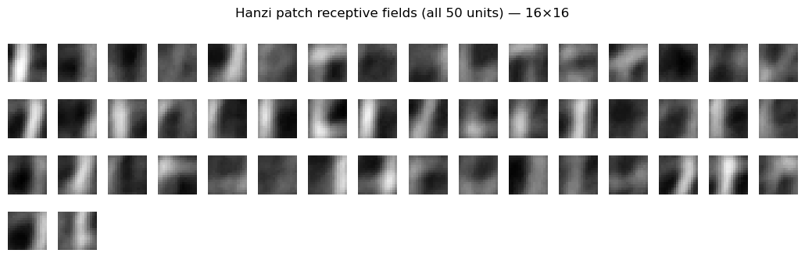
The model learns strokes from randomly cropped patches

